Slide 1
HEART DISEASE PREDICTION
TSP- AI ML Fundamentals (Capstone Project)
Presented By:
Saayaa N – au810021214027
Guided By: Ramar Bose Sr. AI Master Trainer

Slide 2
OUTLINE
Problem Statement
Proposed System/Solution
Algorithm & Deployment
GitHub Link
Project Demo(photos / videos)
Conclusion
Future Scope
References

Slide 3
Problem Statement
.
The goal of this study is to estimate the total risk of heart disease using Logistic Regression and Machine Learning. According to the World Health Organization (WHO), heart attacks account for about four out of every five CVD-related deaths. Identifying people at risk of developing CVD is critical for implementing preventative strategies and delivering timely therapies.

Slide 4
Proposed Solution
The proposed Logistic Regression in Google's collaboration with Heart Disease Prediction includes data processing, feature selection, and model construction. Using the Logistic Regression model of MI, it is possible to assess an individual's risk of developing cardiovascular disease. This model can help healthcare practitioners identify high-risk patients, allowing for focused therapies and lifestyle changes to reduce the risk of CVD-related consequences.

Slide 5
Algorithm & Deployment
Data Preprocessing: The dataset undergoes preprocessing steps such as handling missing values, encoding categorical variables, and scaling numerical features.
Feature Selection: Relevant features are selected based on their significance in predicting CVD risk, using techniques such as correlation analysis and feature importance ranking.
Model Development: A Logistic Regression model is trained using the preprocessed dataset. The model learns to classify individuals into two classes: those at risk of developing CVD and those not at risk.

Slide 6
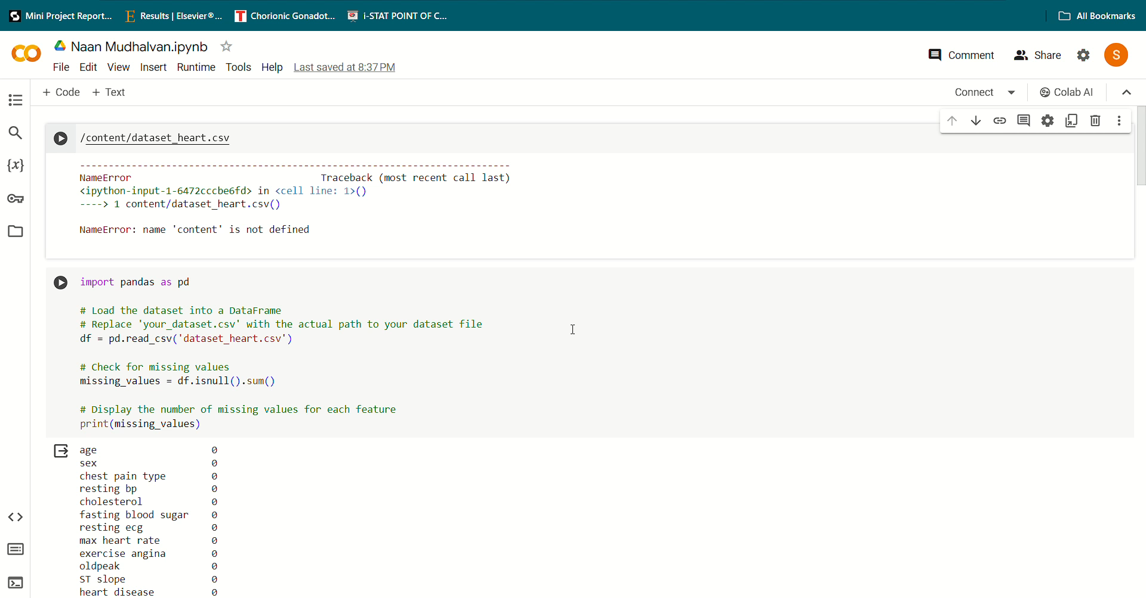
Project Demo(Recorded Video)

Slide 7
GitHub Link
https://github.com/Saayaa4027/Naan_Mudhalvan---Heart-Disease-Prediction/tree/main

Slide 8
Conclusion
The use of Logistic Regression to predict heart disease risk provides useful insights into identifying those who are more likely to develop cardiovascular disease (CVD) and maybe avoid negative health outcomes. Logistic Regression is used to successfully model the probability of CVD occurrence based on numerous risk variables, allowing for early intervention and focused healthcare interventions. The findings highlight the importance of proactive healthcare activities, such as lifestyle adjustments, regular screenings, and individualized therapies, to reduce CVD risk factors and improve patient outcomes.

Slide 9
Future Scope
The future of heart disease prediction using Logistic Regression seems bright on a variety of fronts. Advanced predictive models are expected to emerge when additional risk indicators are added and sophisticated machine learning techniques are applied, resulting in improved accuracy and reliability in identifying persons at risk of cardiovascular disease (CVD). Furthermore, the paradigm of personalized medicine is poised to revolutionize heart disease management

Slide 10
References
Project Github link, Ramar Bose , 2024
Project video recorded link (youtube/github), Ramar Bose , 2024
Project PPT & Report github link, Ramar Bose , 2024

Slide 11
THANK YOU

